Slide 1
Caesar cipher

Slide 2
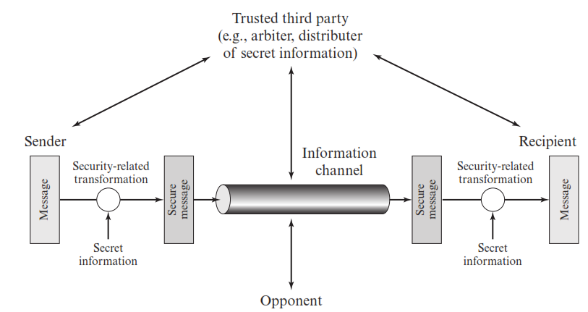
Network security model

Slide 3
Terminologies
Plain text: Original message
Cipher text: Coded message
Encryption: The process of converting plain text to cipher text
Decryption: The process of restoring plain text from cipher text
Cryptography: Study of these encryption schemes
Cryptanalysis: Techniques used for decrypting the message without any knowledge of encryption
Cryptology = Cryptography + Cryptanalysis

Slide 4
Cryptographic system characterization
Operations used for transforming plain text to cipher text:
Types: Substitution, Transposition
Number of keys used:
Types: Symmetric, Asymmetric
The way in which plain text is processed:
Types: Block cipher, Stream cipher

Slide 5
Caesar cipher
Substitution cipher used by Julius Caesar
It works by shifting the letters in the plaintext message by a certain number of positions, known as the “shift” or “key”.
To cipher a given text we need an integer value, known as a shift which indicates the number of positions each letter of the text has been moved down

Slide 6
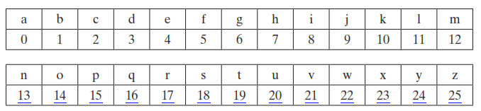


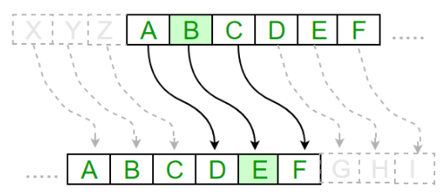

Slide 7
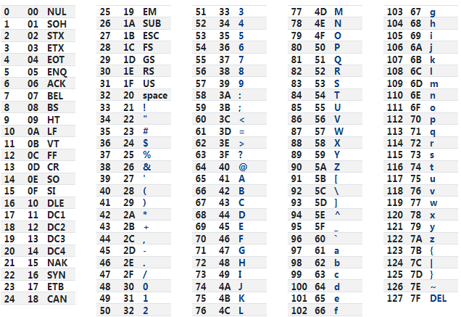
ASCII Table

Slide 8
Example
Encryption
Plain text: HELLO
H becomes K
E becomes H
L becomes O
L becomes O
O becomes R
Cipher text: KHOOR
Decryption
Cipher text: KHOOR
K becomes H
H becomes E
O becomes L
O becomes L
R becomes O
Plain text: HELLO

Slide 9
Features of Caesar cipher
Substitution cipher
Fixed key
Symmetric encryption
Limited key space
Vulnerable to brute force attack
Encryption and decryption algorithms are known
Only 26 keys to try
Language of plaintext is known and easily recognizable
Easy to implement

Slide 10
import java.io.BufferedReader;
import java.io.IOException;
import java.io.InputStreamReader;
import java.util.Scanner;
public class CeaserCipher
{
static Scanner sc=new Scanner(System.in);
static BufferedReader br=new BufferedReader(new InputStreamReader(System.in));
public static void main(String[] args)throws IOException
{
System.out.print("Enter any String:");
String str = br.readLine();
System.out.print(" \nEnter the Key:");
int key = sc.nextInt();
String encrypted = encrypt(str,key);
System.out.println("\nEncrypted String is:"+encrypted);
String decrypted = decrypt(encrypted,key);
System.out.println("\nDecrypted String is:" + decrypted);
System.out.println("\n");
}
str = Hello World
key = 3

Slide 11
public static String encrypt(String str, int key)
{ String encrypted = "";
for(int i=0;i<str.length();i++)
{
int c=str.charAt(i);
if(Character.isUpperCase(c))
{
c=c+(key%26);
if(c>'Z')
c=c-26;
} else if(Character.isLowerCase(c))
{
c=c+(key%26);
if(c>'z')
c=c-26;
}
encrypted+=(char)c;
}
return encrypted;
}
str = Hello World
key = 3
i = 0, i < 10, i++
c = 72
H is uppercase
c = 72+3 % 26 = 75
encrypted = char(75) = K

Slide 12
public static String decrypt(String str,int key)
{
String decrypted = "";
for(int i=0;i<str.length();i++)
{ int c=str.charAt(i);
if(Character.isUpperCase(c))
{
c=c-(key%26);
if(c<'A')
c=c+26;
}
else if(Character.isLowerCase(c))
{
c=c-(key%26);
if(c<'a')
c=c+26;
}
decrypted += (char)c;
} return decrypted;
} }
str = Khoor Zruog
key = 3
i = 0, i < 10, i++
c = 75
K is uppercase
c = 75 - 3 % 26 = 72
decrypted = char(72) = H

Slide 13
Enter any String:Hello World
Enter the Key:3
Encrypted String is:Khoor Zruog
Decrypted String is:Hello World

Slide 14
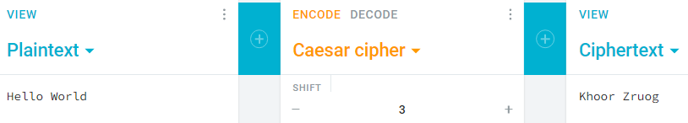
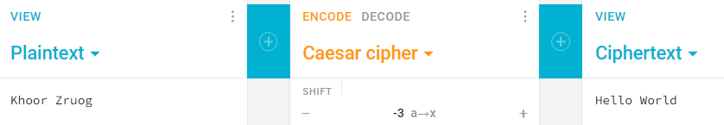
Verification using cryptii.com
Encryption
Decryption

